Slide 1
أكـــــاديميــــة طــــويـــق
Deep Learning

Slide 2
Object Detection
YOLO- YOU LOOK ONLY ONCE
By: Dr. Afshan Hashmi

Slide 3
Course Objectives:
Understanding Object Detection
YOLO- you look only once
Features of YOLO
Working of YOLO Object Detection
Different Version of YOLO and its comparison
Implementing of YOLO

Slide 4
Object Detection
Object detection is a computer vision task that involves both:
Classifying objects in an image (what is in the image?),
Localizing them with bounding boxes (where is the object?).
It is different from just image classification (which says what is in the image) because it tells what and where the objects are.
Key Components of Object Detection:
Component | Description
Bounding Box | A rectangle drawn around an object. Defined by x, y (top-left), width, height.
Class Label | What object is in the box (e.g., “cat”, “car”)
Confidence Score | How sure the model is that the object is of a certain class.

Slide 5
Key Architectures
(1) YOLO (You Only Look Once)
Concept: Single-shot detector that predicts bounding boxes and class probabilities in one pass.
Versions: YOLOv1 (2015) to YOLOv8 (2023)
Strengths:
Real-time performance (45+ FPS)
Good trade-off between speed and accuracy
(2) SSD (Single Shot MultiBox Detector)
Concept: Uses predefined anchor boxes at multiple feature map scales.
Strengths:
Faster than two-stage detectors (Faster R-CNN)
Handles objects of different sizes well
(3) Faster R-CNN
Concept: Two-stage detector (Region Proposal Network + ROI Pooling).
Strengths:
Higher accuracy than YOLO/SSD
Better for small objects

Slide 6
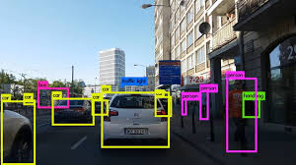
What is YOLO
YOLO stands for You Only Look Once.
It's a state-of-the-art algorithm for real-time object detection, introduced in 2015 by Joseph Redmon, Santosh Divvala, Ross Girshick, and Ali Farhadi in their paper "You Only Look Once: Unified, Real-Time Object Detection."
It achieves this by spatially separating bounding boxes and assigning probabilities to each detected object within an image using a single convolutional neural network (CNN).

Slide 7
Features of the YOLO algorithm:
Speed: YOLO is exceptionally fast, processing images at 45 Frames Per Second (FPS) and even reaching 91 FPS according to the provided graphic, significantly outperforming other object detectors.
High Detection Accuracy: YOLO achieves accuracy far beyond other state-of-the-art models, with minimal background errors.
Better Generalization: Especially newer YOLO versions, demonstrate improved generalization to new and unseen domains, making it suitable for robust object detection applications. The "Automatic Detection of Melanoma with Yolo Deep Convolutional Neural Networks" paper illustrates the improved mAP of later YOLO versions (v2 and v3) compared to v1 for melanoma detection.
Open-Source: Being open-source has fostered continuous community-driven improvements to the YOLO model.

Slide 8
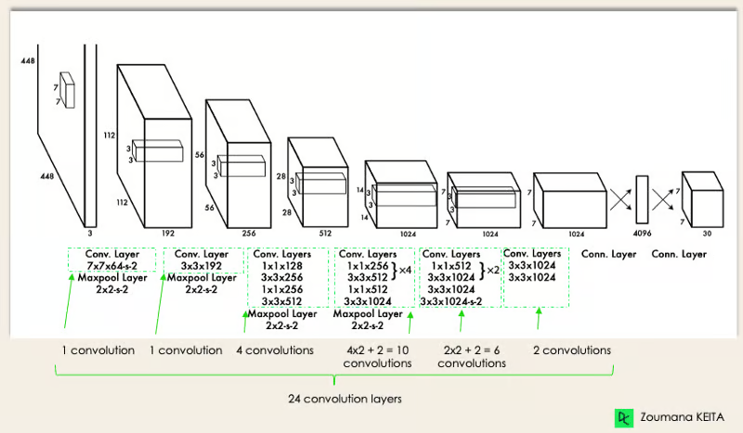
YOLO Architecture
YOLO architecture is similar to GoogleNet. As illustrated below, it has 24 convolutional layers, four max-pooling layers, and two fully connected layers.

Slide 9
YOLO Architecture- Explained
The architecture works as follows:
Resizes the input image into 448x448 before going through the convolutional network.
A 1x1 convolution is first applied to reduce the number of channels, followed by a 3x3 convolution to generate a cuboidal output.
The activation function under the hood is ReLU, except for the final layer, which uses a linear activation function.
Some additional techniques, such as batch normalization and dropout, regularize the model and prevent it from overfitting.

Slide 10
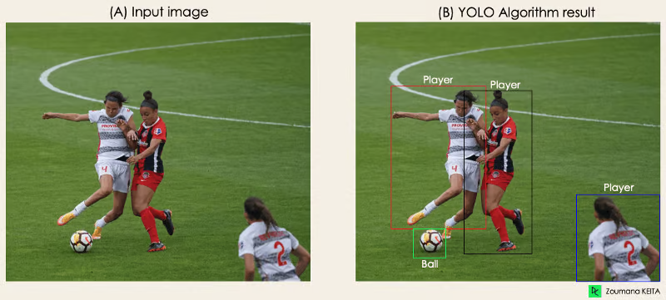
Working of YOLO Object Detection
The algorithm works based on the following four approaches:
Residual blocks
Bounding box regression
Intersection Over Unions or IOU for short
Non-Maximum Suppression.

Slide 11
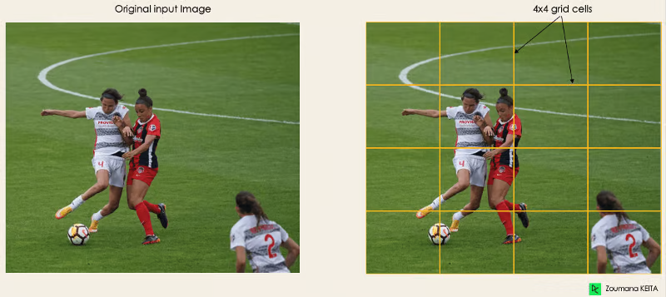
Working of YOLO Object Detection
1. Residual blocks
This first step starts by dividing the original image (A) into NxN grid cells of equal shape, where N, in our case, is 4, as shown in the image on the right. Each cell in the grid is responsible for localizing and predicting the class of the object that it covers, along with the probability/confidence value.

Slide 12
Working of YOLO Object Detection
2. Bounding box regression
The next step is to determine the bounding boxes corresponding to rectangles, highlighting all the objects in the image. We can have as many bounding boxes as there are objects within a given image.
YOLO determines the attributes of these bounding boxes using a single regression module in the following format, where Y is the final vector representation for each bounding box.
Y = [pc, bx, by, bh, bw, c1, c2]
This is especially important during the training phase of the model.
pc corresponds to the probability score of the grid containing an object. For instance, all the grids in red will have a probability score higher than zero.

Slide 13
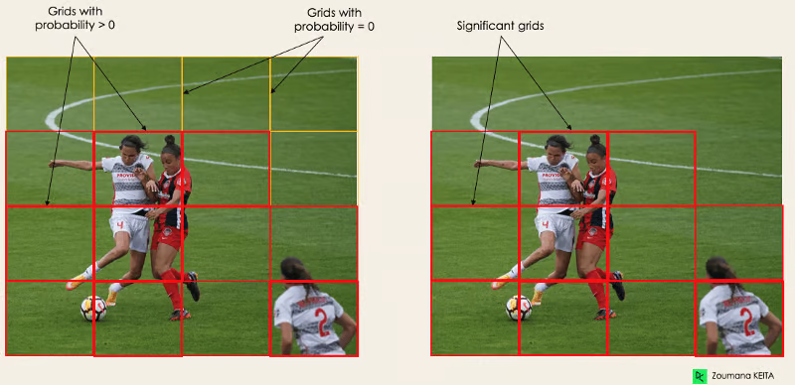
Working of YOLO Object Detection
The image on the right is the simplified version since the probability of each yellow cell is zero (insignificant).
bx, by are the x and y coordinates of the center of the bounding box with respect to the enveloping grid cell.
bh, bw correspond to the height and the width of the bounding box with respect to the enveloping grid cell.
c1 and c2 correspond to the two classes, Player and Ball.
We can have as many classes as your use case requires.

Slide 14
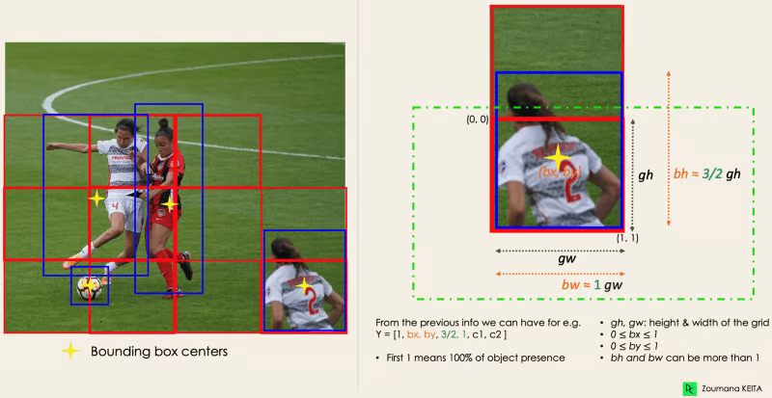
Working of YOLO Object Detection
To understand, let’s pay closer attention to the player on the bottom right.
To understand, let’s pay closer attention to the player on the bottom right.

Slide 15
Working of YOLO Object Detection
To understand, let’s pay closer attention to the player on the bottom right.
3. Intersection Over Unions or IOU
Most of the time, a single object in an image can have multiple grid box candidates for prediction, even though not all are relevant. The goal of the IOU (a value between 0 and 1) is to discard such grid boxes to only keep those that are relevant. Here is the logic behind it:
The user defines its IOU selection threshold, which can be, for instance, 0.5.
Then, YOLO computes the IOU of each grid cell, which is the Intersection area divided by the Union Area.
Finally, it ignores the prediction of the grid cells having an IOU ≤ threshold and considers those with an IOU > threshold.

Slide 16
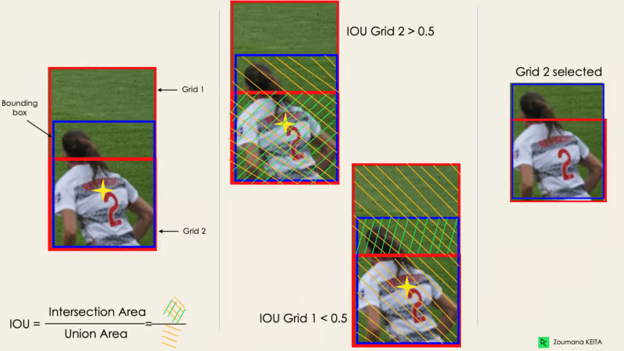
Working of YOLO Object Detection
To understand, let’s pay closer attention to the player on the bottom right.
Below is an illustration of applying the grid selection process to the bottom left object. We can observe that the object originally had two grid candidates, and only “Grid 2” was selected at the end.

Slide 17
Working of YOLO Object Detection
To understand, let’s pay closer attention to the player on the bottom right.
4. Non-Max Suppression or NMS
Setting a threshold for the IOU is not always enough because an object can have multiple boxes with IOU beyond the threshold, and leaving all those boxes might include noise. Here is where we can use NMS to keep only the boxes with the highest probability detection score.

Slide 18
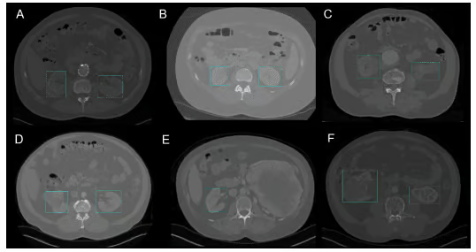
YOLO Applications
YOLO object detection has different applications in our day-to-day life. In this section, we will cover some of them in the following domains: healthcare, agriculture, security surveillance, and self-driving cars.Object detection has been introduced in many practical industries, such as healthcare and agriculture. Let’s understand each one with specific examples.
Healthcare
Specifically, in surgery, it can be challenging to localize organs in real time due to biological diversity from one patient to another. Kidney Recognition in CT used YOLOv3 to facilitate localizing kidneys in 2D and 3D from computerized tomography (CT) scans.

Slide 19
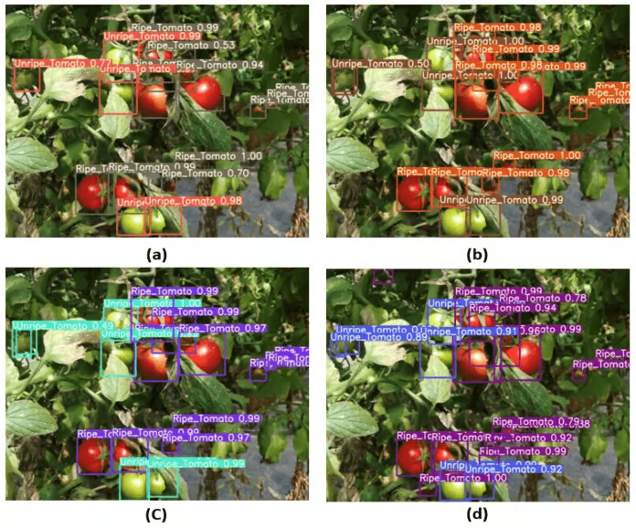
YOLO Applications
Agriculture
Artificial Intelligence and robotics play a major role in modern agriculture. Harvesting robots are vision-based robots that were introduced to replace manual picking of fruits and vegetables. One of the best models in this field uses YOLO

Slide 20
Different versions of YOLO
YOLO has evolved through multiple versions, each improving speed, accuracy, and functionality. Here's a concise breakdown of key YOLO versions:
1. YOLOv1 (2015)
Key Idea: First real-time object detector (45 FPS).
Architecture: Single CNN for bounding box + class prediction (grid-based).
Limitations:
Struggled with small objects.
Low recall compared to two-stage detectors.
2. YOLOv2 (YOLO9000, 2016)
Improvements:
Added Batch Normalization.
Introduced anchor boxes (improved localization).
Used Darknet-19 backbone.
Could detect 9000 classes (hence "YOLO9000").
Speed: 67 FPS (faster than v1).

Slide 21
Different versions of YOLO
3. YOLOv3 (2018)
Major Upgrades:
Darknet-53 backbone (deeper, more accurate).
Multi-scale predictions (3 scales for small/medium/large objects).
Better feature extraction with residual connections.
Performance: 30 FPS with COCO mAP of 33.0.
4. YOLOv4 (2020)
Innovations:
CSPDarknet53 backbone (cross-stage partial networks).
PANet (Path Aggregation Network) for better feature fusion.
Mish activation (improves accuracy).
SPP (Spatial Pyramid Pooling) for multi-scale features.
Speed: 65 FPS on Tesla V100.

Slide 22
Different versions of YOLO
5. YOLOv5 (2020)
Key Features:
PyTorch implementation (easier to use than Darknet).
Auto-learning anchor boxes.
Simplified architecture (focus on usability).
Four variants (s, m, l, x) for speed/accuracy trade-offs.
Controversy: Not officially part of the YOLO series (developed by Ultralytics).
6. YOLOv6 (2022)
Developed by Meituan (focused on industrial applications).
Improvements:
Efficient backbone (RepVGG-style).
Anchor-free detection (simpler than anchor-based).
Hardware-friendly design (optimized for GPUs).

Slide 23
Different versions of YOLO
7. YOLOv7 (2022)
Contributions:
Trainable bag-of-freebies (improves accuracy without inference cost).
Extended efficient layer aggregation (E-ELAN).
Model scaling for different compute budgets.
Performance: Outperformed YOLOv4/v5 in accuracy/speed trade-offs.
8. YOLOv8 (2023)
Latest Version (by Ultralytics):
Anchor-free by default.
User-friendly API (train/export/deploy with few lines of code).
Advanced features:
Instance segmentation.
Pose estimation (keypoint detection).
Five pre-trained sizes (nano to extra-large).
Speed/Accuracy: 50 FPS at 53.9 mAP on COCO.

Slide 24
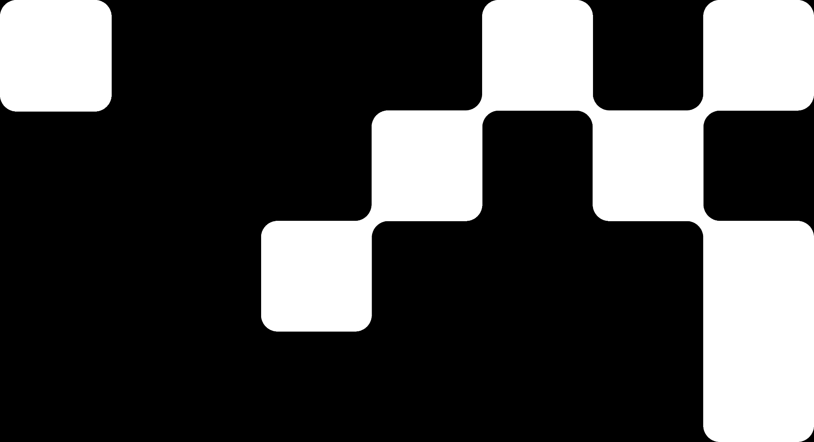
Comparison Table
Version | Backbone | mAP (COCO) | FPS | Key Feature
YOLOv1 | Custom CNN | 63.4 (VOC) | 45 | First real-time detector
YOLOv2 | Darknet-19 | 76.8 (VOC) | 67 | Anchor boxes
YOLOv3 | Darknet-53 | 33.0 | 30 | Multi-scale predictions
YOLOv4 | CSPDarknet53 | 43.5 | 65 | SPP, PANet, Mish
YOLOv5 | CSP-like | 55.6 | 140* | PyTorch, auto-anchors
YOLOv6 | RepVGG-style | 52.5 | 100* | Anchor-free, industrial focus
YOLOv7 | E-ELAN | 56.8 | 160* | Trainable bag-of-freebies
YOLOv8 | CSPDarknet-like | 53.9 | 50 | Segmentation/pose, anchor-free

Slide 25

Hands On Exercise
Click Here For The Implementation on Google Colab
https://drive.google.com/file/d/1M5yilm19fqi9BxUyGsIxGkKG3Zbp-oze/view?usp=share_link

Slide 26
Books and References
"Deep Learning" (Ian Goodfellow et al.)
"Neural Networks and Deep Learning" (Michael Nielsen)
Deep Learning for Computer Vision (Rajalingappaa Shanmugamani)
Courses: CS231n (Stanford), Fast.ai
Datasets: COCO, Pascal VOC, Cityscapes
www.Datacamp.com

Slide 27


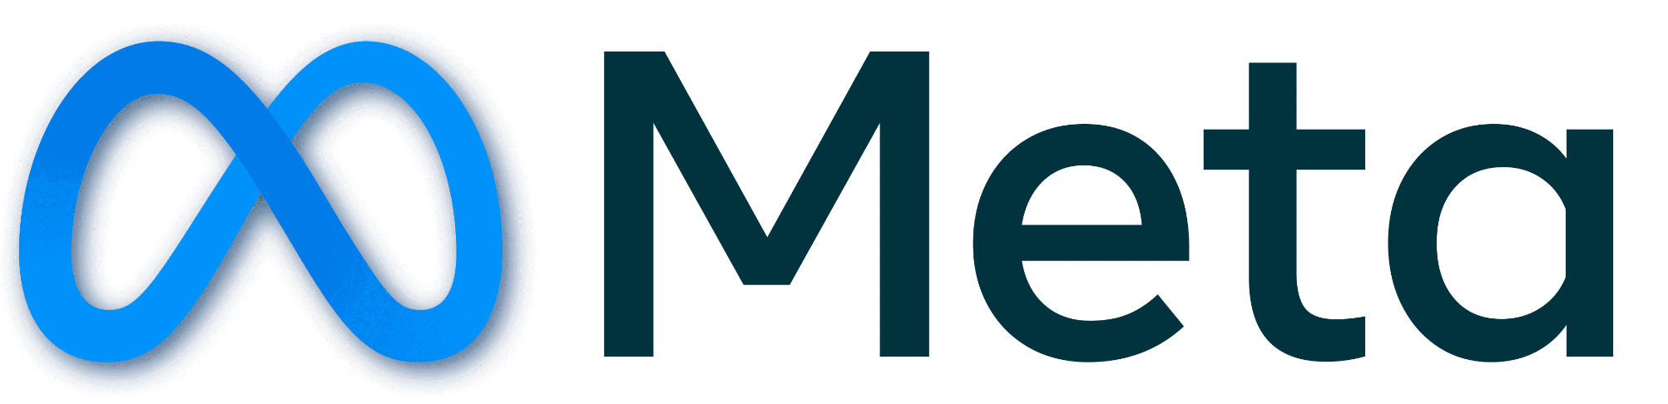





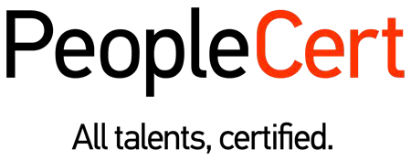
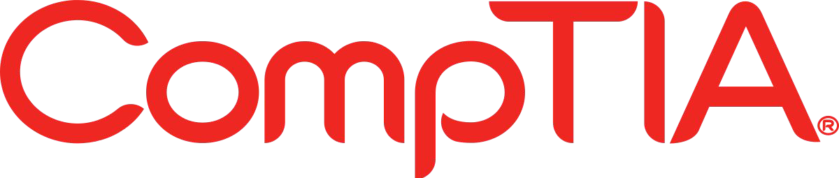







الشراكات العالمية

Slide 28
شــــــكــــرًا لكــــــم
THANK YOU

